Slide 1
Differentiable optimization for control and reinforcement learning
Brandon Amos
Meta AI NYC, Fundamental AI Research (FAIR)
Slides available at:
github.com/bamos/presentations
brandondamos
bamos.github.io
Collaborators: Akshay Agrawal, Shane Barratt, Byron Boots, Stephen Boyd, Roberto Calandra, Steven Diamond, Priya Donti, Ivan Jimenez, Zico Kolter, Nathan Lambert, Jacob Sacks, Samuel Stanton, Andrew Gordon Wilson, Omry Yadan, and Denis Yarats

Slide 2
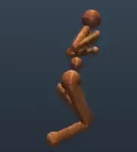
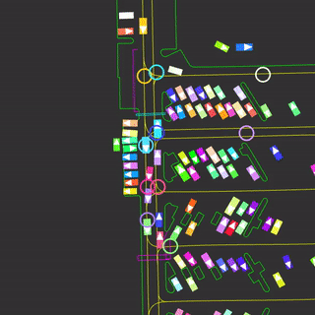
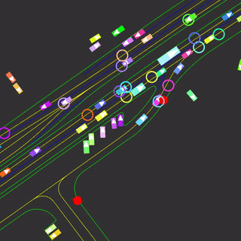
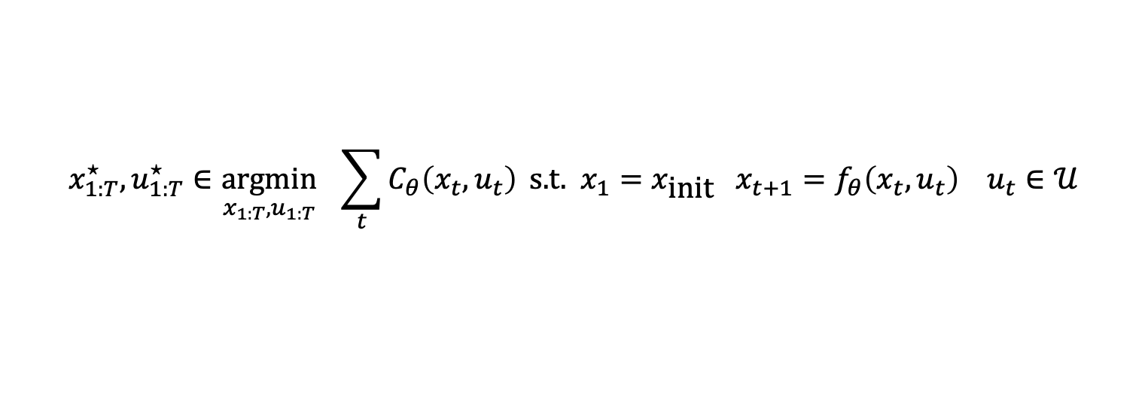
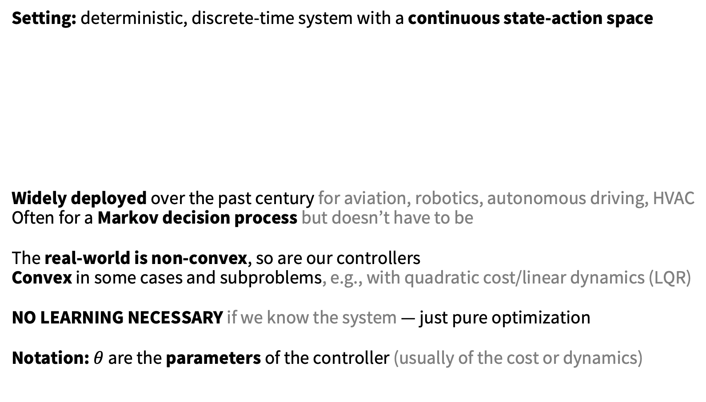
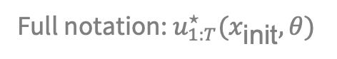
Control is powerful*
*when properly set up
Setting: deterministic, discrete-time system with a continuous state-action space
Widely deployed over the past century for aviation, robotics, autonomous driving, HVAC
Often for a Markov decision process but doesn’t have to be
The real-world is non-convex, so are our controllers
Convex in some cases and subproblems, e.g., with quadratic cost/linear dynamics (LQR)
NO LEARNING NECESSARY if we know the system — just pure optimization
Notation: $θ$ are the parameters of the controller (usually of the cost or dynamics)
cost
initial state
dynamics
constraints
$${x_{1:T}^{⋆}, u}_{1:T}^{⋆}∈\underset{{x_{1:T}, u}_{1:T}}{argmin}{ \sum_{t}{C_{θ}\left(x_{t}, u_{t}\right)}} \text{s}\text{.}\text{t}\text{. }x_{1}=x_{\text{init}} x_{t+1}=f_{θ}\left(x_{t}, u_{t}\right) u_{t}∈𝒰$$
Full notation: $u_{1:T}^{⋆}(x_{\text{init}}, θ)$

Slide 3
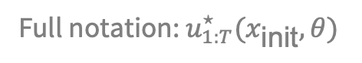
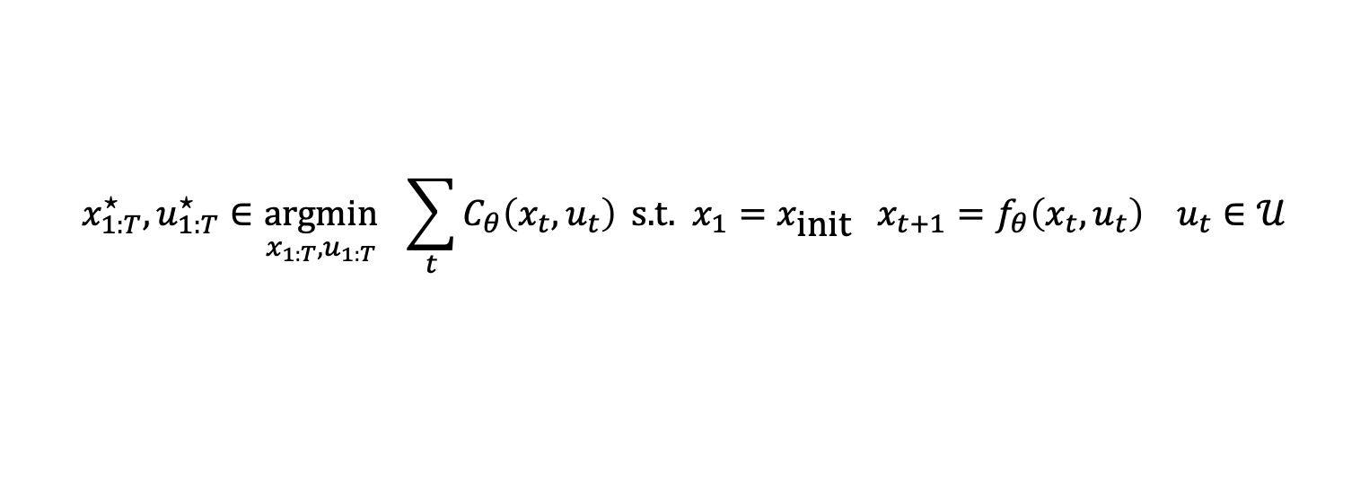
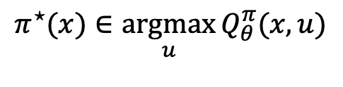
Model-free RL and control
Take the cost to be the (negated) value estimate, no dynamics
Value estimate approximates the model-based objective
Policy learning performs amortized optimization
Viewpoint leads to a model-based to model-free spectrum:
take short-horizon model-based rollouts with a value estimate at the end
cost
initial state
dynamics
constraints
$${x_{1:T}^{⋆}, u}_{1:T}^{⋆}∈\underset{{x_{1:T}, u}_{1:T}}{argmin}{ \sum_{t}{C_{θ}\left(x_{t}, u_{t}\right)}} \text{s}\text{.}\text{t}\text{. }x_{1}=x_{\text{init}} x_{t+1}=f_{θ}\left(x_{t}, u_{t}\right) u_{t}∈𝒰$$
Full notation: $u_{1:T}^{⋆}(x_{\text{init}}, θ)$
$$π^{⋆}(x)∈\underset{u}{argmax}{Q_{θ}^{π}(x, u)}$$

Slide 4
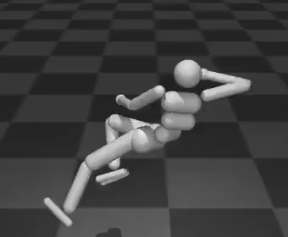
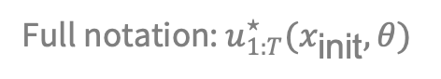
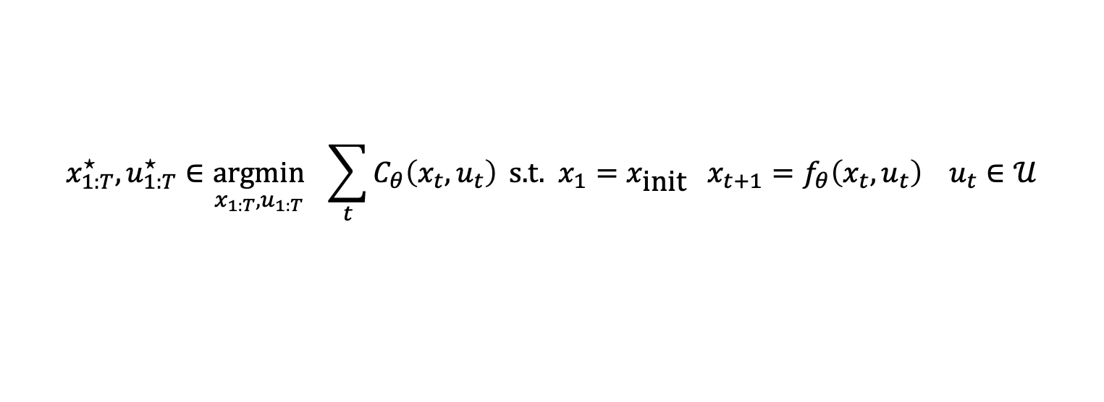
Control may fail for many reasons
cost
initial state
dynamics
constraints
$${x_{1:T}^{⋆}, u}_{1:T}^{⋆}∈\underset{{x_{1:T}, u}_{1:T}}{argmin}{ \sum_{t}{C_{θ}\left(x_{t}, u_{t}\right)}} \text{s}\text{.}\text{t}\text{. }x_{1}=x_{\text{init}} x_{t+1}=f_{θ}\left(x_{t}, u_{t}\right) u_{t}∈𝒰$$
Full notation: $u_{1:T}^{⋆}(x_{\text{init}}, θ)$
Control starts failing us when we can’t describe everything
Impossible to analytically encode every detail of non-trivial systems
Cost and dynamics may be unknown, mis-specified, or inaccurate
Especially difficult in high-dimensional state-action spaces
Learning methods help but are not perfect
system identification, learning dynamics, inverse cost learning

Slide 5
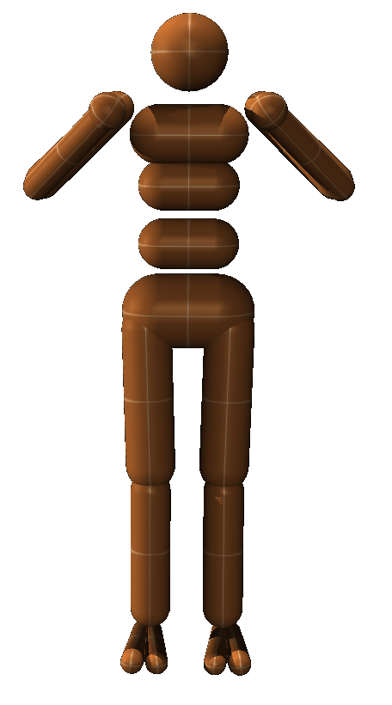
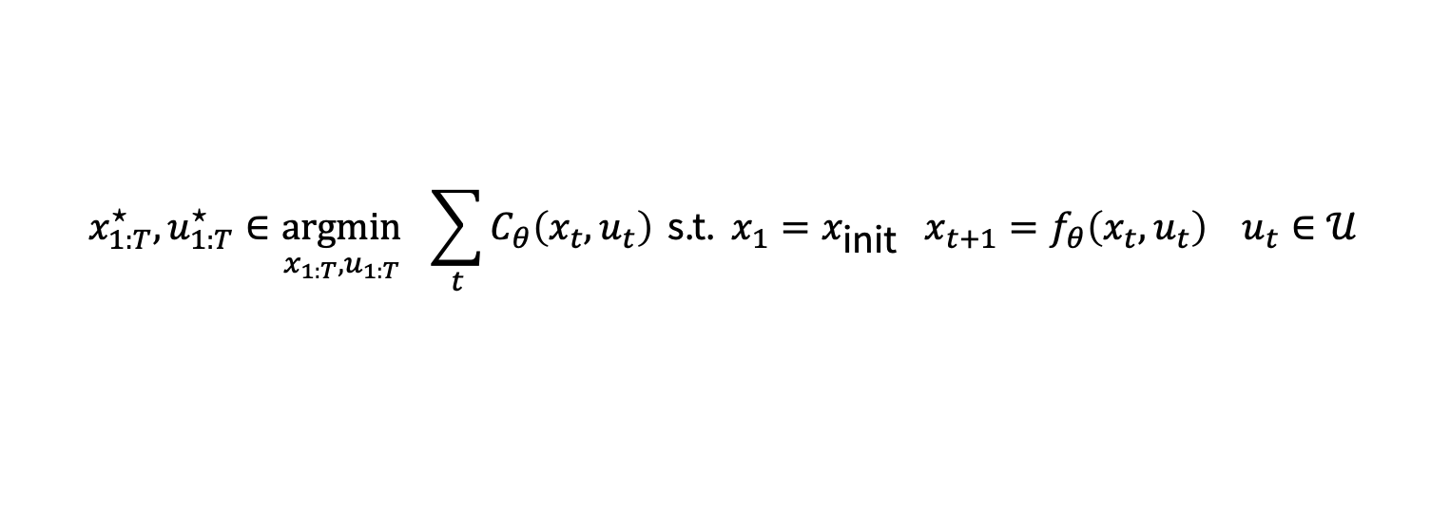
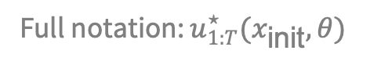
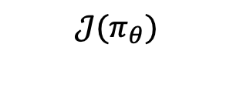
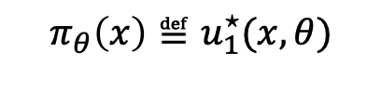
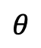
Controllers don’t live in isolation
We can often measure the downstream performance induced by the controller
Idea: optimize (i.e., tune/learn) the parameters for a downstream performance metric
Controller-design loop is not a new idea and has been extensively used over the past century
$$θ$$
controller parameters
(design space of cost and model)
solve control optimization problem
cost
initial state
dynamics
constraints
$${x_{1:T}^{⋆}, u}_{1:T}^{⋆}∈\underset{{x_{1:T}, u}_{1:T}}{argmin}{ \sum_{t}{C_{θ}\left(x_{t}, u_{t}\right)}} \text{s}\text{.}\text{t}\text{. }x_{1}=x_{\text{init}} x_{t+1}=f_{θ}\left(x_{t}, u_{t}\right) u_{t}∈𝒰$$
Full notation: $u_{1:T}^{⋆}(x_{\text{init}}, θ)$
$$π_{θ}\left(x\right)≝u_{1}^{⋆}(x, θ)$$
execute control policy on the system
$$𝒥(π_{θ})$$
measure downstream performance of the controller

Slide 6
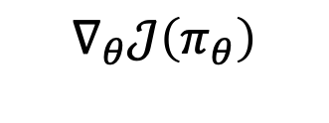

This talk: differentiate the controller!
We can often measure the downstream performance induced by the controller
Idea: optimize (i.e., tune/learn) the parameters for a downstream performance metric
by differentiating through the control optimization problem
$$θ$$
controller parameters
(design space of cost and model)
solve control optimization problem
cost
initial state
dynamics
constraints
$${x_{1:T}^{⋆}, u}_{1:T}^{⋆}∈\underset{{x_{1:T}, u}_{1:T}}{argmin}{ \sum_{t}{C_{θ}\left(x_{t}, u_{t}\right)}} \text{s}\text{.}\text{t}\text{. }x_{1}=x_{\text{init}} x_{t+1}=f_{θ}\left(x_{t}, u_{t}\right) u_{t}∈𝒰$$
differentiable control
$$∇_{θ}𝒥\left(π_{θ}\right)$$
or ${\text{D}}_{θ}\left(π_{θ}(x)\right)$
Full notation: $u_{1:T}^{⋆}(x_{\text{init}}, θ)$
$$π_{θ}\left(x\right)≝u_{1}^{⋆}(x, θ)$$
execute control policy on the system
$$𝒥(π_{θ})$$
measure downstream performance of the controller

Slide 7
This talk: differentiate the controller!
Foundations of differentiable optimization and control
Unrolling or autograd (gradient descent, differentiable cross-entropy method)
Implicit differentiation (convex and non-convex MPC)
cvxpylayers: Prototyping differentiable convex optimization and control
Applications of differentiable control
Objective mismatch
Amortized control

Slide 8
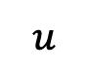
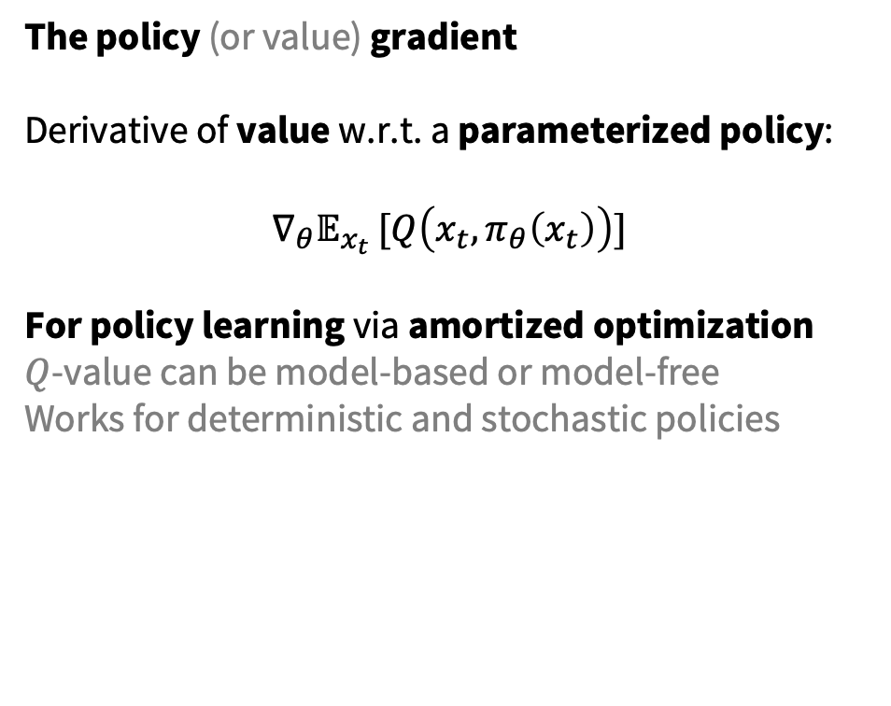
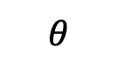
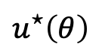
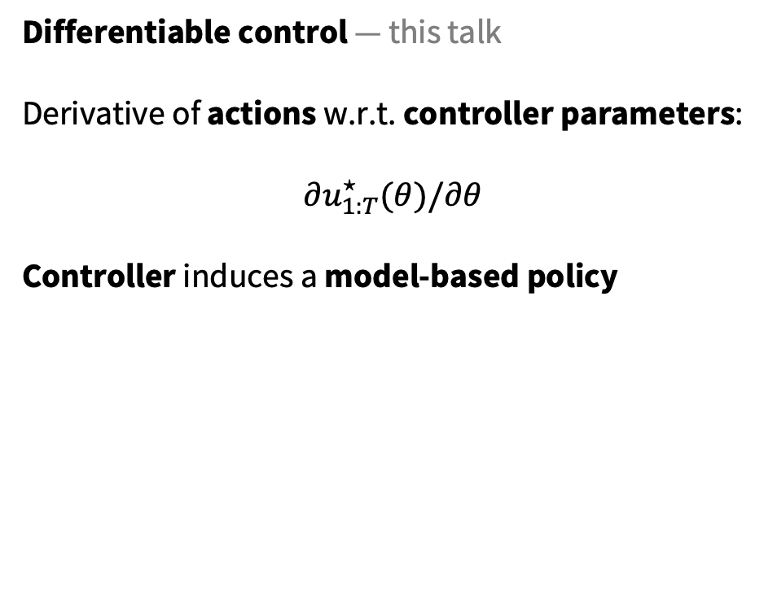
Derivatives in RL and control
The policy (or value) gradient Derivative of value w.r.t. a parameterized policy:
$$∇_{θ}𝔼_{x_{t} }[Q\left(x_{t}, π_{θ}\left(x_{t}\right)\right)]$$
For policy learning via amortized optimization
$Q$-value can be model-based or model-free
Works for deterministic and stochastic policies
Differentiable control — this talk
Derivative of actions w.r.t. controller parameters:
$$∂u_{1:T}^{⋆}(θ)/∂θ$$
Controller induces a model-based policy
$$u^{⋆}\left(θ\right)$$
$$u$$
$$θ$$
Each vertical slice is a control problem

Slide 9
How to differentiate the controller?
Unrolling or autograd
Idea: Implement controller, let autodiff do the rest
Like MAML’s unrolled gradient descent
Ideal when unconstrained with a short horizon
Does not require a fixed-point or optimal solution
Instable and resource-intensive for large horizons
Can unroll algorithms beyond gradient descent
The differentiable cross-entropy method
Implicit differentiation
Idea: Differentiate controller’s optimality conditions
Agnostic of the control algorithm
Ill-defined if controller gives suboptimal solution
Memory and compute efficient: free in some cases
$$D_{θ}u^{⋆}\left(θ\right)=−D_{u}g{\left(θ,u^{⋆}\left(θ\right)\right)}^{−1}D_{θ}g\left(θ, u^{⋆}\left(θ\right)\right)$$

Slide 10
How to differentiate the controller?
Unrolling or autograd
Idea: Implement controller, let autodiff do the rest
Like MAML’s unrolled gradient descent
Ideal when unconstrained with a short horizon
Does not require a fixed-point or optimal solution
Instable and resource-intensive for large horizons
Can unroll algorithms beyond gradient descent
The differentiable cross-entropy method
Implicit differentiation
Idea: Differentiate controller’s optimality conditions
Agnostic of the control algorithm
Ill-defined if controller gives suboptimal solution
Memory and compute efficient: free in some cases
$$D_{θ}u^{⋆}\left(θ\right)=−D_{u}g{\left(θ,u^{⋆}\left(θ\right)\right)}^{−1}D_{θ}g\left(θ, u^{⋆}\left(θ\right)\right)$$

Slide 11
The Differentiable Cross-Entropy Method (DCEM)
The cross-entropy method (CEM) optimizer:
1. Samples from the domain with a Gaussian 2. Updates the Gaussian with the top-k values
Solves challenging non-convex control problems
The differentiable cross-entropy method (DCEM):
Use unrolling to differentiate through CEM using:
1. the reparameterization trick for sampling
2. a differentiable top-k operation (LML)

Slide 12
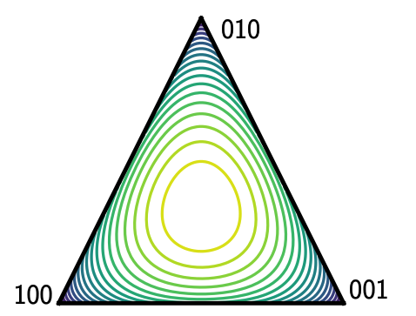
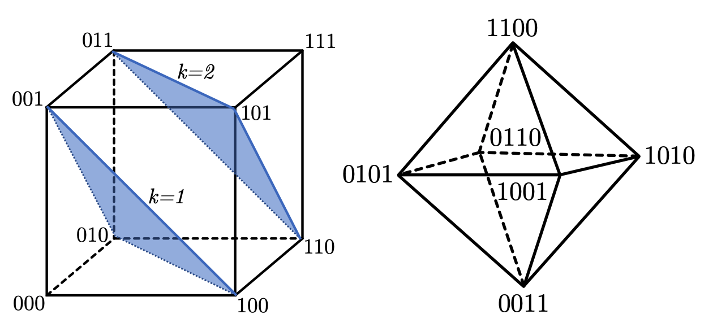
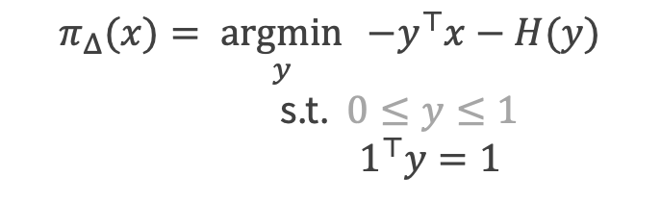
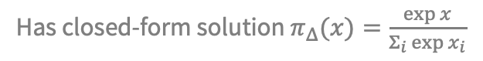
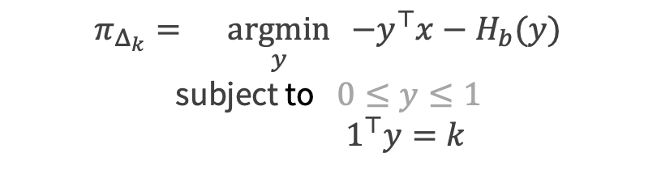
From the softmax to soft/differentiable top-k
Constrained softmax, constrained sparsemax, Limited Multi-Label Projection
$$π_{Δ}(x)=\underset{y}{argmin}{ −y^{⊤}x−H(y)} \\ \text{s}\text{.}\text{t}\text{.} 0≤y≤1$$
$${ 1}^{⊤}y=1$$
$$π_{Δ_{k}}=\underset{y}{argmin}{ −y^{⊤}x−H_{b}(y)} \\ \text{subject} \text{to} 0≤y≤1$$
$$1^{⊤}y=k$$
Has closed-form solution $π_{Δ}(x)=\frac{\exp{x}}{Σ_{i}\exp{x_{i}}}$
No closed-form solution, can still differentiate
Entropy penalty of the softmax
top-k polytope

Slide 13
How to differentiate the controller?
Unrolling or autograd
Idea: Implement controller, let autodiff do the rest
Like MAML’s unrolled gradient descent
Ideal when unconstrained with a short horizon
Does not require a fixed-point or optimal solution
Instable and resource-intensive for large horizons
Can unroll algorithms beyond gradient descent
The differentiable cross-entropy method
Implicit differentiation
Idea: Differentiate controller’s optimality conditions
Agnostic of the control algorithm
Ill-defined if controller gives suboptimal solution
Memory and compute efficient: free in some cases
$$D_{θ}u^{⋆}\left(θ\right)=−D_{u}g{\left(θ,u^{⋆}\left(θ\right)\right)}^{−1}D_{θ}g\left(θ, u^{⋆}\left(θ\right)\right)$$

Slide 14
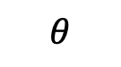
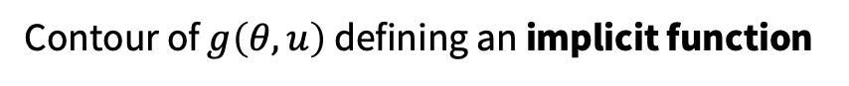
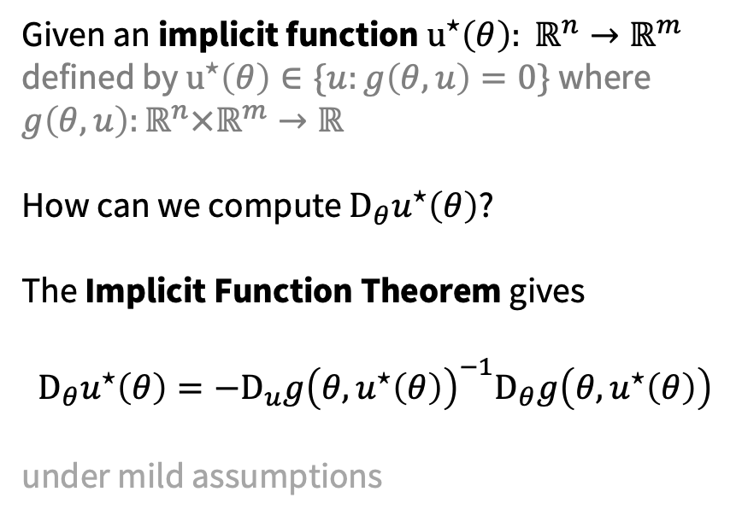
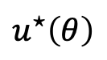


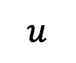
The Implicit Function Theorem
Dini 1877, Dontchev and Rockafellar 2009
Contour of $g\left(θ, u\right)$ defining an implicit function
Given an implicit function $u^{⋆}\left(θ\right): ℝ^{n}→ℝ^{m}$ defined by $u^{⋆}\left(θ\right)∈\{u:g\left(θ,u\right)=0\}$ where $g\left(θ,u\right):ℝ^{n}×ℝ^{m}→ℝ$
How can we compute $D_{θ}u^{⋆}\left(θ\right)$?
The Implicit Function Theorem gives $$D_{θ}u^{⋆}\left(θ\right)=−D_{u}g{\left(θ,u^{⋆}\left(θ\right)\right)}^{−1}D_{θ}g\left(θ, u^{⋆}\left(θ\right)\right)$$ under mild assumptions
$$u^{⋆}\left(θ\right)$$
$$D_{θ}g(θ, u^{⋆}\left(θ\right))$$
$$u$$
$$D_{u}g(θ, u^{⋆}\left(θ\right))$$
$$θ$$
Each vertical slice is a control problem

Slide 15
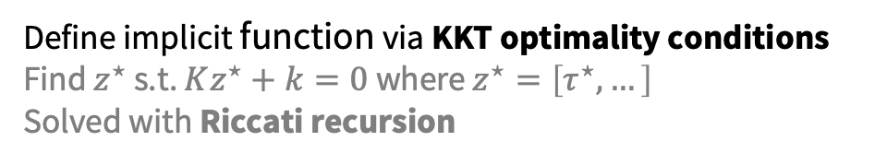
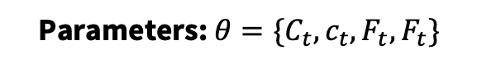
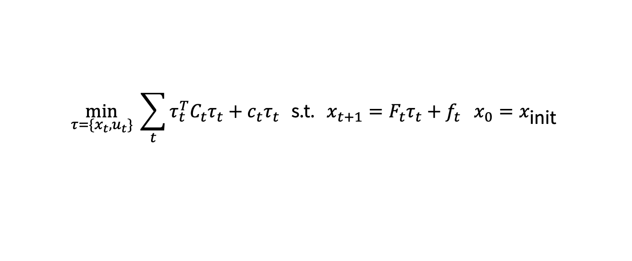
Implicitly differentiating convex LQR control
$$\min_{τ=\{x_{t}, u_{t}\}}{ \sum_{t}{τ_{t}^{T}C_{t}τ_{t}+c_{t}τ_{t} }} \text{s}\text{.}\text{t}\text{. }x_{t+1}=F_{t}τ_{t}+f_{t} x_{0}=x_{\text{init}}$$
Parameters: $θ=\{C_{t}, c_{t},F_{t}, F_{t}\}$
Define implicit function via KKT optimality conditions
Find $z^{⋆}$ s.t. $Kz^{⋆}+k=0$ where $z^{⋆}=\left[τ^{⋆},…\right]$
Solved with Riccati recursion
Backward pass: implicitly differentiate the LQR KKT conditions:
where
Just another LQR problem!

Slide 16
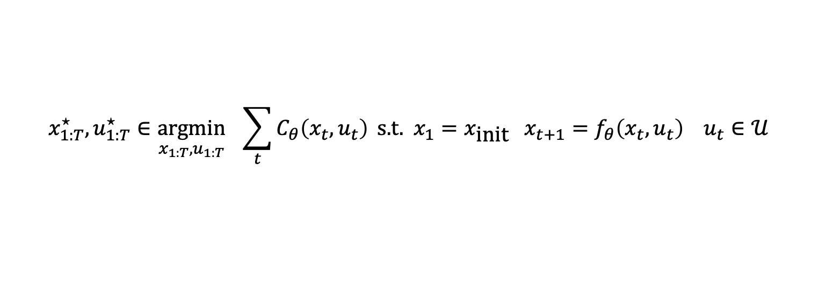
Differentiating non-convex MPC
cost
initial state
dynamics
constraints
$${x_{1:T}^{⋆}, u}_{1:T}^{⋆}∈\underset{{x_{1:T}, u}_{1:T}}{argmin}{ \sum_{t}{C_{θ}\left(x_{t}, u_{t}\right)}} \text{s}\text{.}\text{t}\text{. }x_{1}=x_{\text{init}} x_{t+1}=f_{θ}\left(x_{t}, u_{t}\right) u_{t}∈𝒰$$
Solve with sequential quadratic programming (SQP)
Approximate non-convex argmin with the final convex approximation
Backward pass: differentiate the convex approximation, e.g., with:
where
Just an LQR problem! (in some cases)

Slide 17
This talk: differentiate the controller!
Foundations of differentiable optimization and control
Unrolling or autograd (gradient descent, differentiable cross-entropy method)
Implicit differentiation (convex and non-convex MPC)
cvxpylayers: Prototyping differentiable convex optimization and control
Applications of differentiable control
Objective mismatch
Amortized control

Slide 18
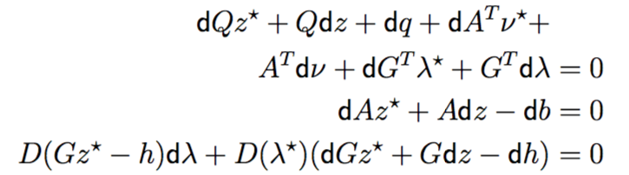
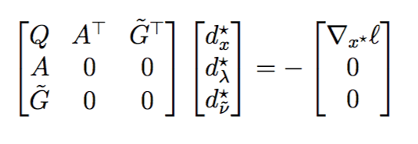
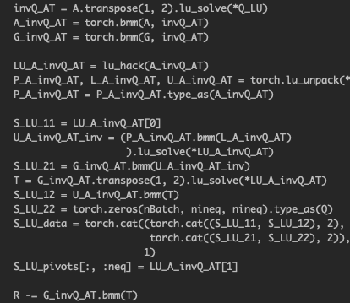
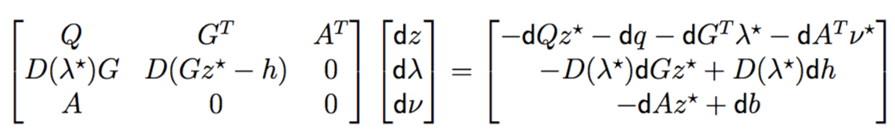
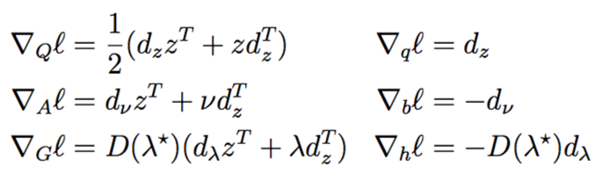
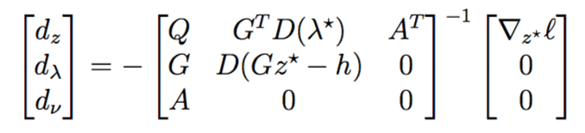
Optimization layers need to be carefully implemented

Slide 19
Why should practitioners care?

Slide 20
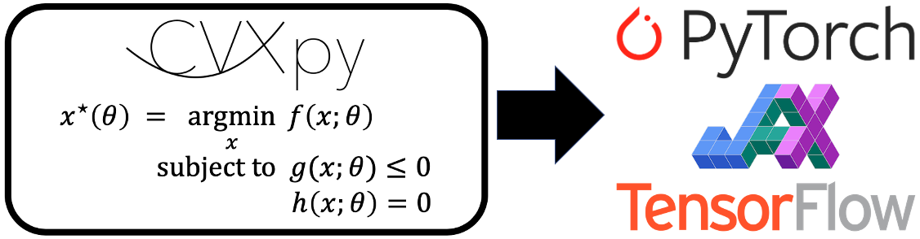

Differentiable convex optimization layers
NeurIPS 2019 and officially in CVXPY!
Joint work with A. Agrawal, S. Barratt, S. Boyd, S. Diamond, J. Z. Kolter
Useful for convex control problems and subproblems
locuslab.github.io/2019-10-28-cvxpylayers

Slide 21
Rapidly prototyping optimization layers

Slide 22
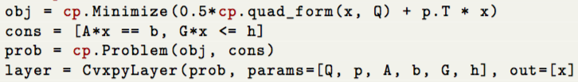
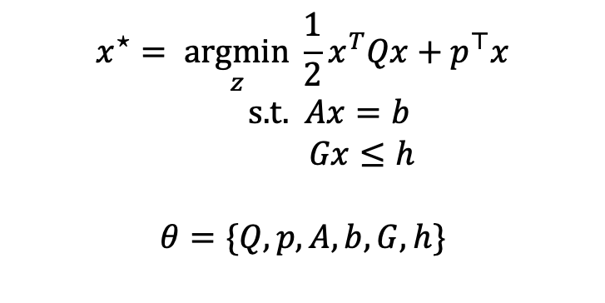
Code example: OptNet QP
Before: 1k lines of code Hand-implemented and optimized PyTorch GPU-capable batched primal-dual interior point method
Now: <10 lines of code Same speed
$$x^{⋆}=\underset{z}{argmin}{\frac{1}{2}x^{T}Qx+p^{⊤}x} \\ \text{s}\text{.}\text{t}\text{. } Ax=b \\ Gx≤h$$
$$θ=\{Q,p,A,b,G,h\}$$
Write standard CVXPY problem
Export to PyTorch, TensorFlow, JAX

Slide 23
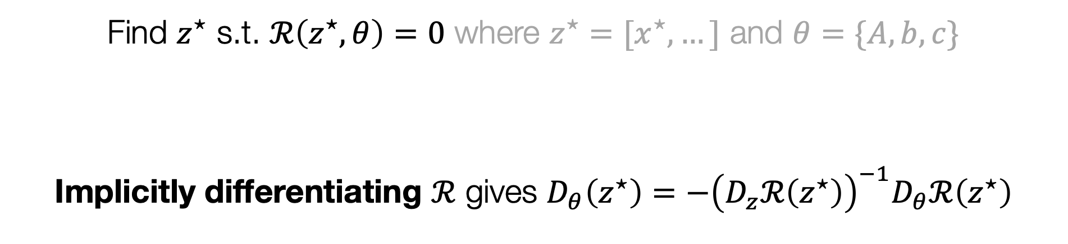
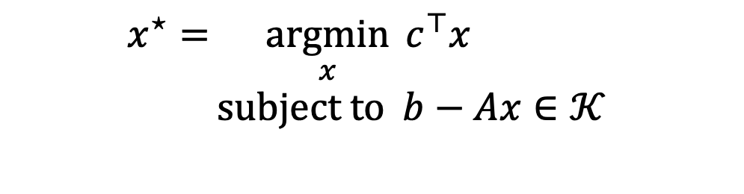
Under the hood: cone program differentiation
Section 7 of my thesis and in Agrawal et al.
$$x^{⋆}=\underset{x}{argmin}{c^{⊤}x} \\ subject to b−Ax∈𝒦$$
Conic Optimality
Find $z^{⋆}$ s.t. $ℛ\left(z^{⋆}, θ\right)=0$ where $z^{⋆}=[x^{⋆},…]$ and $θ=\{A,b,c\}$
Implicitly differentiating $ℛ$ gives $D_{θ}\left(z^{⋆}\right)=−{\left(D_{z}ℛ\left(z^{⋆}\right)\right)}^{−1}D_{θ}ℛ\left(z^{⋆}\right)$

Slide 24
This talk: differentiate the controller!
Foundations of differentiable optimization and control
Unrolling or autograd (gradient descent, differentiable cross-entropy method)
Implicit differentiation (convex and non-convex MPC)
cvxpylayers: Prototyping differentiable convex optimization and control
Applications of differentiable control
Objective mismatch
Amortized control

Slide 25
The Objective Mismatch Problem
Summary: Maximum-likelihood training of dynamics separate from controlling the dynamics
Especially problematic with inaccurate models
The controller (i.e. policy) optimizes over the dynamics
Can find adversarial trajectories that appear deceptively “good”
Differentiable control one potential solution, may be combined with many others:
advantage weighting, value-gradient weighting, value-aware model learning

Slide 26
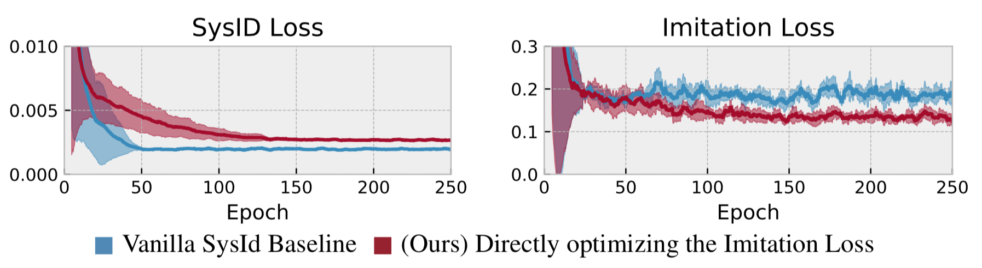
Optimizing the task loss is better than SysID
Best Imitation Loss
Approximate Model Class
True Model
Best MSE
True System: Pendulum environment with noise (damping and a wind force) Approximate Model: Pendulum without the noise terms
~1.8x difference!

Slide 27





Optimizing system models with a task loss
Among many others!

Slide 28
This talk: differentiate the controller!
Foundations of differentiable optimization and control
Unrolling or autograd (gradient descent, differentiable cross-entropy method)
Implicit differentiation (convex and non-convex MPC)
cvxpylayers: Prototyping differentiable convex optimization and control
Applications of differentiable control
Objective mismatch
Amortized control

Slide 29


RL policy learning is amortized optimization
Setup: controlling a continuous MDP with a model-free policy $π_{θ}\left(x\right)$
Review: Learning a policy with a value gradient amortizes over the $Q$-value:
$$\underset{θ}{argmax}{𝔼_{p\left(x\right)} Q(x, π_{θ}\left(x\right))}$$
$π_{θ}(x)$ is fully amortized: tries to predict the max-$Q$ operation without looking at the $Q$ function!
The amortization perspective easily enables us to consider other policies

Slide 30



Amortized control via unrolled gradient descent
The policy’s prediction is adapted to maximize the $Q$ function for every state
Unrolled gradient descent: policy has knowledge it is going to be adapted
Can generalize to other differentiable optimizers, e.g., the cross-entropy method

Slide 31

Optimal control sequences share structure
Full control sequence space
Control optimization problems are repeatedly solved for every state
Optimal control sequences do not live in isolation and share structure
Use differentiable control to learn a latent subspace
Only search over optimal solutions rather than the entire space
Amortizes the original control optimization problem
Subspace of optimal solutions
Cartpole videos
Optimal controls over time — force on the cartpole
Time

Slide 32


DCEM learns the solution space structure
$$u^{⋆}=\underset{u∈{\left[0,1\right]}^{N}}{argmin}{f\left(u\right)}$$
Full control sequence space
Subspace of optimal solutions
Latent space of optimal solutions

Slide 33
Closing Thoughts And Future Directions
Differentiable optimization and control are powerful primitives to use within larger systems
Theoretical and engineering foundations are here
Works for convex and non-convex control
Specify and hand-engineer the parts you know, learn the rest
Can be propagated through and learned, just like any layer
Applications in:
Objective mismatch
Amortized optimization
Safe and robust control
Learning state embeddings

Slide 34
Differentiable optimization for control and reinforcement learning
Brandon Amos
Meta AI NYC, Fundamental AI Research (FAIR)
Slides available at:
github.com/bamos/presentations
brandondamos
bamos.github.io
Differentiable QPs: OptNet [Amos and Kolter, ICML 2017]
Differentiable task-based stochastic optimization [Donti, Amos, Kolter, NeurIPS 2017]
Differentiable MPC for end-to-end planning and control [Amos, Jimenez, Sacks, Boots, Kolter, NeurIPS 2018]
Differentiable Convex Optimization Layers [Agrawal*, Amos*, Barratt*, Boyd*, Diamond*, Kolter*, NeurIPS 2019]
Differentiable optimization-based modeling for ML [Amos, Ph.D. Thesis 2019]
Differentiable Cross-Entropy Method [Amos and Yarats, ICML 2020]
Objective mismatch in model-based reinforcement learning [Lambert, Amos, Yadan, Calandra, L4DC 2020]
On the model-based stochastic value gradient [Amos, Stanton, Yarats, Wilson, L4DC 2021]
Tutorial on amortized optimization [Amos, arXiv 2022]
Collaborators: Akshay Agrawal, Shane Barratt, Byron Boots, Stephen Boyd, Roberto Calandra, Steven Diamond, Priya Donti, Ivan Jimenez, Zico Kolter, Nathan Lambert, Jacob Sacks, Samuel Stanton, Andrew Gordon Wilson, Omry Yadan, and Denis Yarats

